Slide 1
Machine Learning from Disaster
F#unctional Londoners @ Skills Matter
Phil Trelford 2013 @ptrelford
Notes:
http://www.kaggle.com/c/titanic-gettingStarted

Slide 2
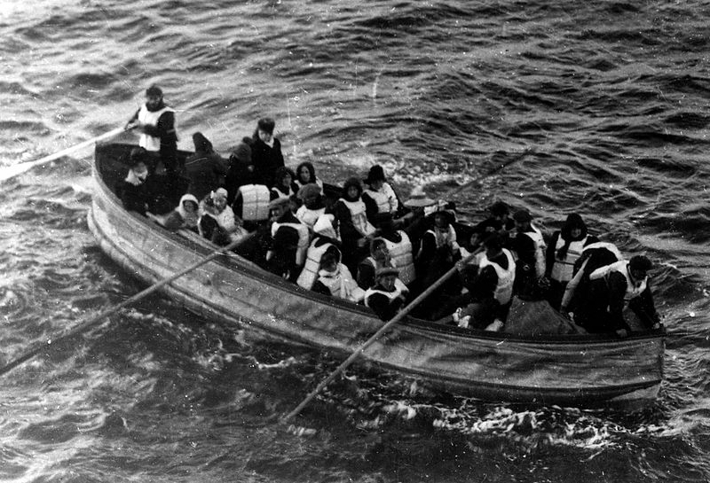
RMS Titanic
On April 15, 1912, during her maiden voyage, the Titanic sank after colliding with an iceberg, killing 1502 out of 2224 passengers and crew.
…there were not enough lifeboats for the passengers and crew.
…some groups of people were more likely to survive than others, such as women, children, and the upper-class.
Notes:
http://www.kaggle.com/c/titanic-gettingStarted

Slide 3
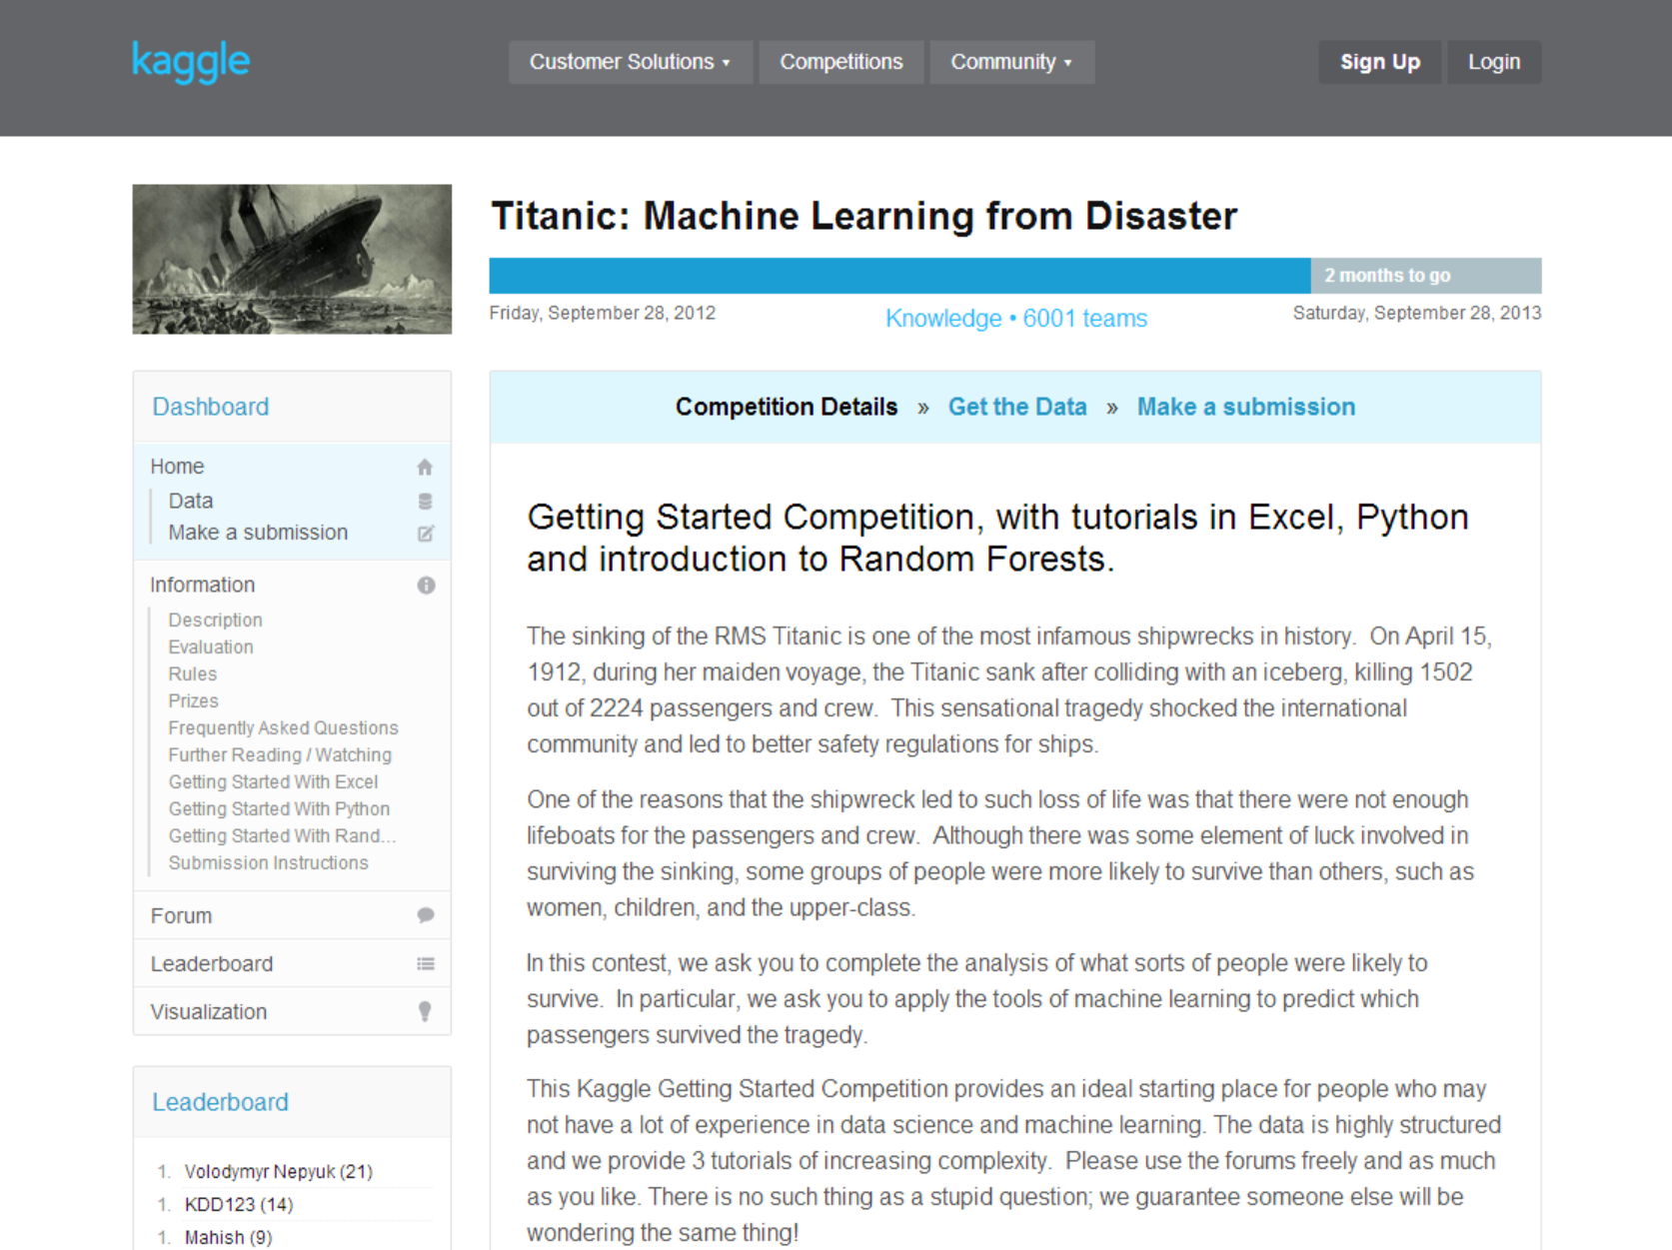
Kaggle competition

Slide 4
Kaggle Titanic dataset
train.csv
test.csv
Notes:
http://www.kaggle.com/c/titanic-gettingStarted/data

Slide 5
Titanic Data
Variable | Description
survival | Survival (0 = No; 1 = Yes)
pclass | Passenger Class (1 = 1st; 2 = 2nd; 3 = 3rd)
name | Name
sex | Sex
age | Age
sibsp | Number of Siblings/Spouses Aboard
parch | Number of Parents/Children Aboard
ticket | Ticket Number
fare | Passenger Fare
cabin | Cabin
embarked | Port of Embarkation (C = Cherbourg; Q = Queenstown; S = Southampton)
Tips:
* Empty floats - Double.Nan
Notes:
http://www.kaggle.com/c/titanic-gettingStarted/data

Slide 6
data analysis
Titanic: Machine Learning from Disaster

Slide 7
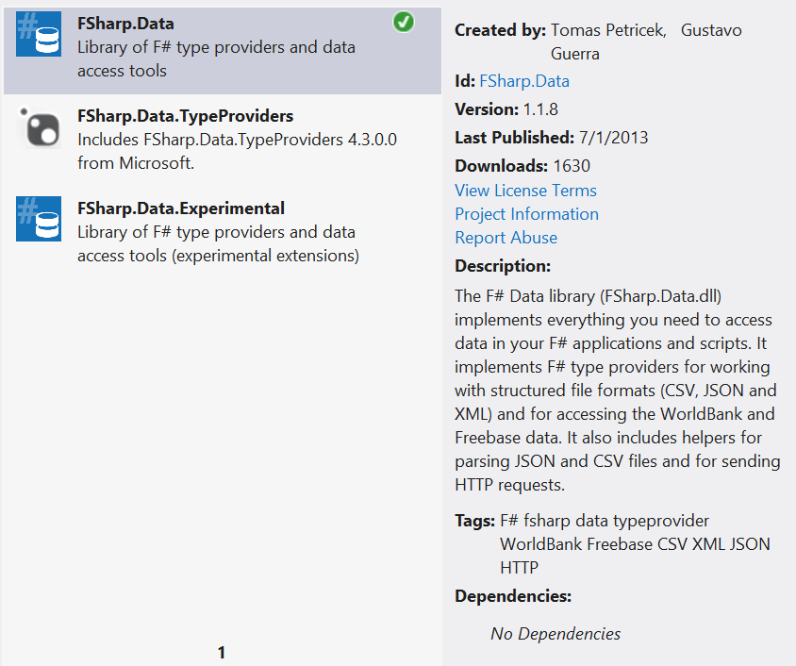
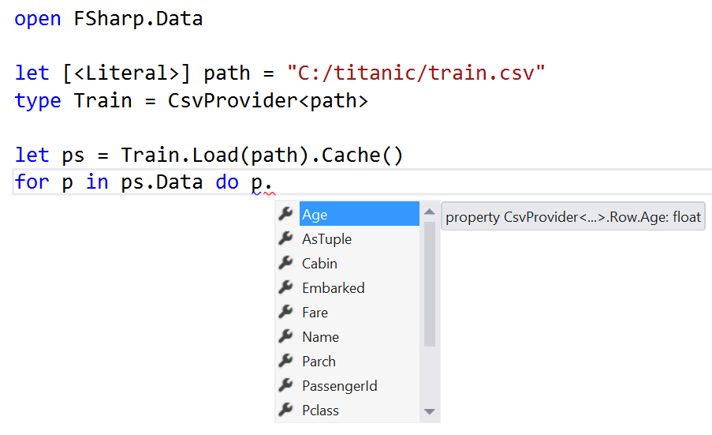
FSharp.Data: CSV Provider
Notes:
http://fsharp.github.io/FSharp.Data/library/CsvProvider.html
http://clear-lines.com/blog/post/Random-Forest-classification-in-F-first-cut.aspx

Slide 8
Counting
let female (passenger:Passenger) = passenger.Sex = “female”
let survived (passenger:Passenger) = passenger.Survived = 1
let females = passengers |> where female
let femaleSurvivors = females |> tally survived
let femaleSurvivorsPc = females |> percentage survived

Slide 9
Tally Ho!
/// Tally up items that match specified criteria
let tally criteria items =
items |> Array.filter criteria |> Array.length
/// Percentage of items that match specified criteria
let percentage criteria items =
let total = items |> Array.length
let count = items |> tally criteria
float count * 100.0 / float total

Slide 10
Survival rate
/// Survival rate of a criteria’s group
let survivalRate criteria =
passengers |> Array.groupBy criteria
|> Array.map (fun (key,matching) ->
key, matching |> Array.percentage survived
)
let embarked = survivalRate (fun p -> p.Embarked)

Slide 11
Score
let score f = passengers |> Array.percentage (fun p -> f p = p.Survived)
let rate = score (fun p -> (child p || female p) && not (p.Class = 3))

Slide 12
Machine learning
Titanic: Machine Learning from Disaster

Slide 13

20 Questions
The game suggests that the information (as measured by Shannon's entropy statistic) required to identify an arbitrary object is at most 20 bits. The game is often used as an example when teaching people about information theory. Mathematically, if each question is structured to eliminate half the objects, 20 questions will allow the questioner to distinguish between 2²⁰ or 1,048,576 objects.
Notes:
https://en.wikipedia.org/wiki/Twenty_Questions

Slide 14
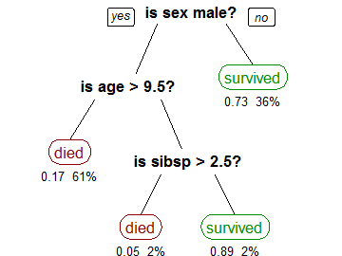
Decision Trees
A tree can be "learned" by splitting the source set into subsets based on an attribute value test. This process is repeated on each derived subset in a recursive manner called recursive partitioning.
Notes:
http://en.wikipedia.org/wiki/Decision_tree_learning

Slide 15
Split data set (from ML in Action)
Python
F#
def splitDataSet(dataSet, axis, value):
retDataSet = []
for featVec in dataSet:
if featVec[axis] == value:
reducedFeatVec = featVec[:axis]
reducedFeatVec.extend(featVec[axis+1:])
retDataSet.append(reducedFeatVec)
return retDataSet
let splitDataSet(dataSet, axis, value) =
[|for featVec in dataSet do
if featVec.[axis] = value then
yield featVec |> Array.removeAt axis|]

Slide 16
Decision Tree
let labels =
[|"sex"; "class"|]
let features (p:Passenger) : obj[] =
[|p.Sex; p.Pclass|]
let dataSet : obj[][] =
[|for passenger in passengers ->
[|yield! features passenger;
yield box (p.Survived = 1)|] |]
let tree = createTree(dataSet, labels)

Slide 17
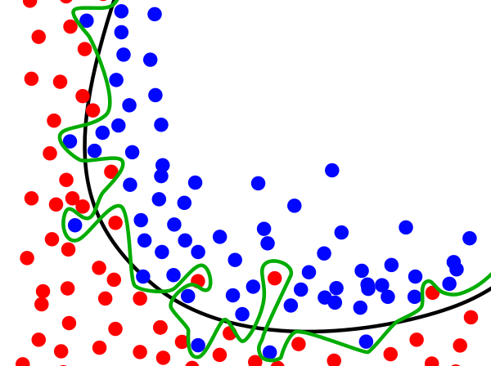
Overfitting
Notes:
http://en.wikipedia.org/wiki/Overfitting

Slide 18
classifY
Titanic: Machine Learning from Disaster

Slide 19
Decision Tree: Create -> Classify
let rec classify(inputTree, featLabels:string[], testVec:obj[]) =
match inputTree with
| Leaf(x) -> x
| Branch(s,xs) ->
let featIndex = featLabels |> Array.findIndex ((=) s)
xs |> Array.pick (fun (value,tree) ->
if testVec.[featIndex] = value
then classify(tree, featLabels,testVec) |> Some
else None
)
Notes:
http://en.wikipedia.org/wiki/Decision_tree_learning
http://clear-lines.com/blog/post/Decision-Tree-classification.aspx

Slide 20
resources
Titanic: Machine Learning from Disaster

Slide 21
Special thanks!
Matthias Brandewinder for the Machine Learning samples
http://www.clear-lines.com/blog/
Tomas Petricek & Gustavo Guerra for the FSharp.Data library
http://fsharp.github.io/FSharp.Data/
F# Team for Type Providers
http://blogs.msdn.com/b/dsyme/archive/2013/01/30/twelve-type-providers-in-pictures.aspx
Peter Harrington for the Machine Learning in Action code samples
http://www.manning.com/pharrington/
Kaggle for the Titanic data set
http://www.kaggle.com/c/titanic-gettingStarted

Slide 22
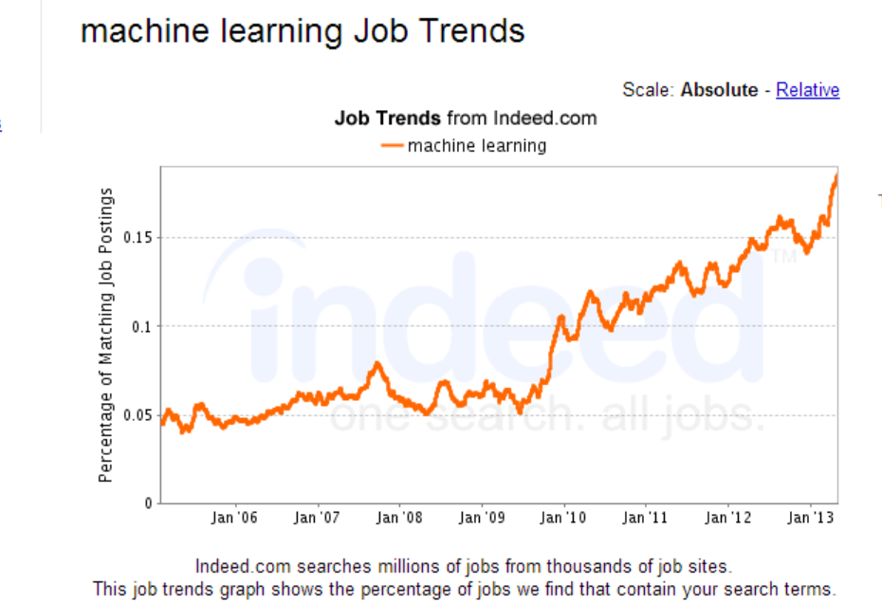
Machine Learning Job Trends
Source indeed.co.uk
Notes:
http://www.indeed.com/jobanalytics/jobtrends?q=machine+learning&l=

Slide 23
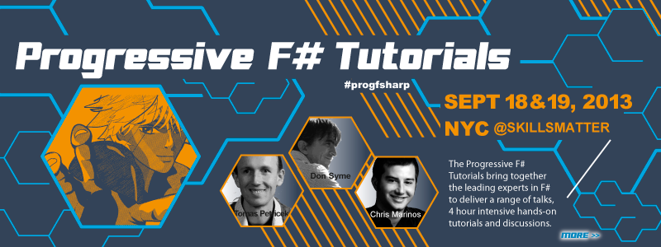
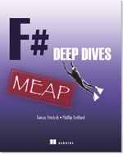

What next?
F# Machine Learning information
http://fsharp.org/machine-learning/
Random Forests
http://tinyurl.com/randomforests
Progressive F# Tutorials
http://skillsmatter.com/event/scala/progressive-f-tutorials-2013

